Slide 1

Big Data Visual Analytics (CS 661)
Instructor: Soumya Dutta
Department of Computer Science and Engineering
Indian Institute of Technology Kanpur (IITK)
email: soumyad@cse.iitk.ac.in

Slide 2
Annoncements
To get a quicker response from me, email to my CSE email and not to my IITK email:
My CSE email: soumyad@cse.iitk.ac.in
Please form groups of 2 among yourselves for assignments
Groups for projects will be formed later in the course
Sometime around the midsem when the project will be assigned

Slide 3
Acknowledgements
Some of the following slides are adapted from the excellent course materials made available by:
Prof. Klaus Mueller (State University of New York at Stony Brook)
Prof. Tamara Munzner (University of British Columbia)

Slide 4
Visual Design and Visual Variables

Slide 5
Key Visual Representations
Gestalt Principles
the tendency to perceive elements as belonging to a group, based on certain visual properties
Pre-attentiveness
certain low level visual aspects are recognized before conscious awareness
Visual variables
the different visual aspects that can be used to encode information

Slide 6
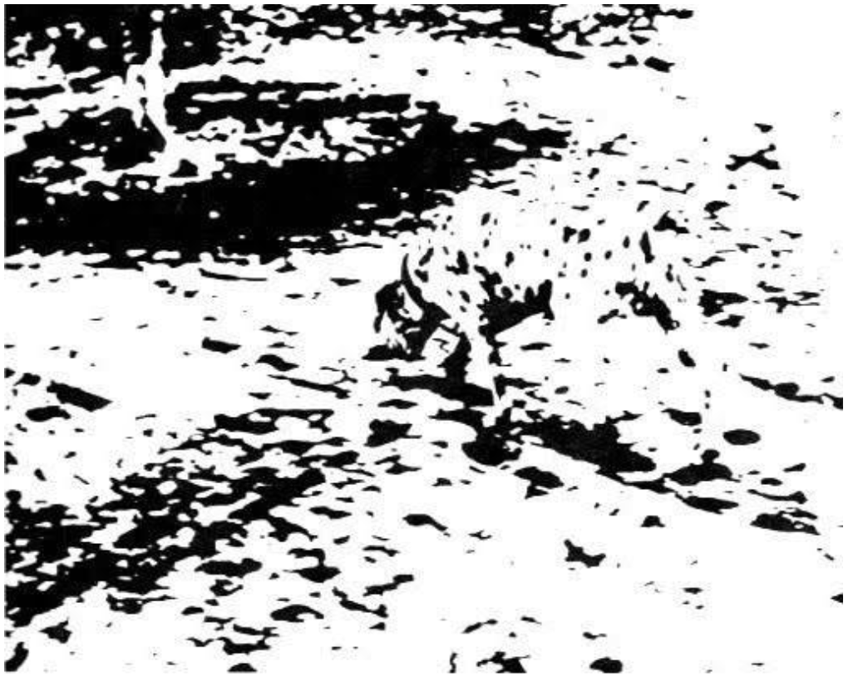
Gestalt Principles
Concept of totality
“Gestalt” is German for “unified whole”
Grasp the "totality" of something before worrying about the details

Slide 7
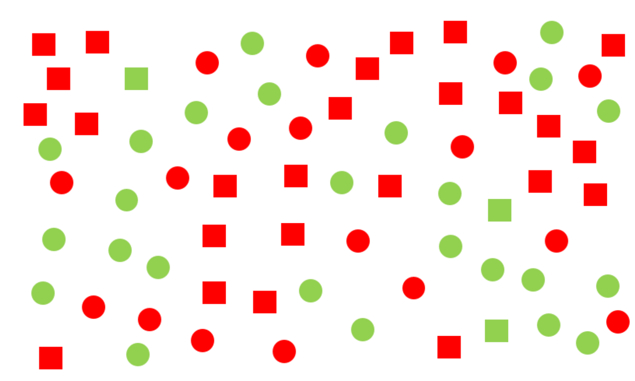
Pre-attentiveness
Also called pop-out

Slide 8
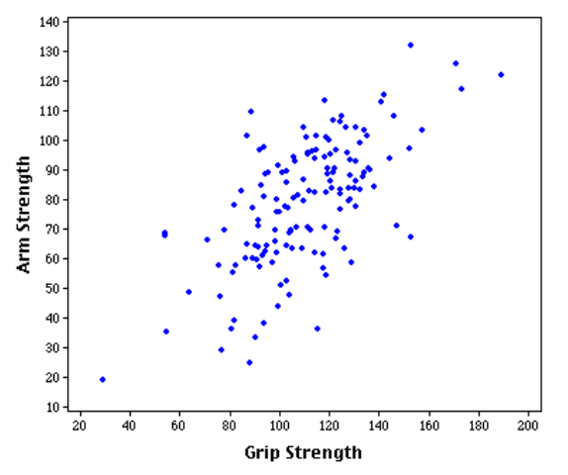
Visual Variables
Two planar variables
Spatial dimensions
Map (arm, grip) to (x,y)

Slide 9
Visual Variables
Two planar variables
Spatial dimensions
Map (arm, grip) to (x,y)
Six Retinal variables
Size
Color
Shape
Orientation
Texture
Brightness

Slide 10
Visual Variables
Two planar variables
Spatial dimensions
Map (arm, grip) to (x,y)
Six Retinal variables
Size
Color
Shape
Orientation
Texture
Brightness
Retinal variables allow for one more variable to be encoded

Slide 11
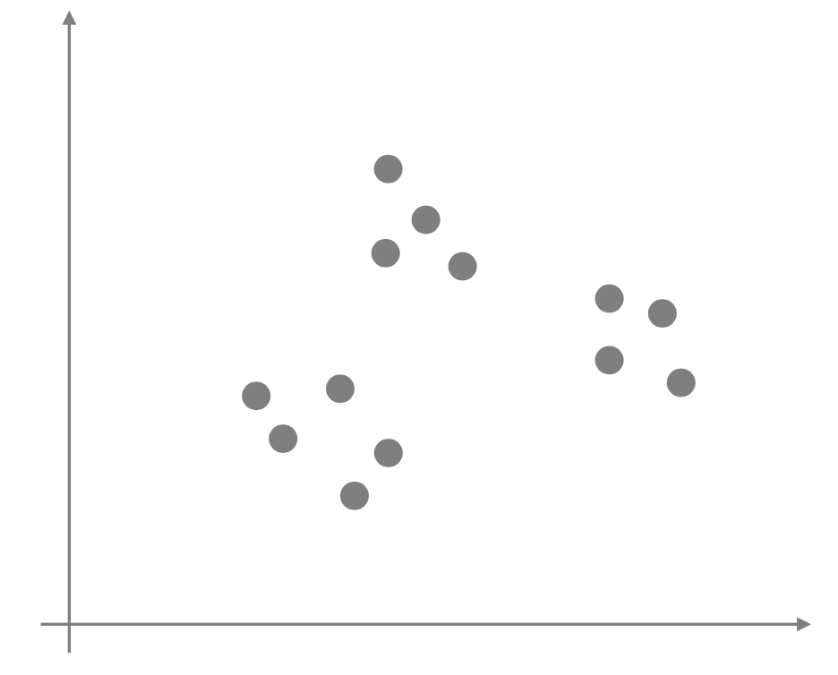
Visual Variables: Planar

Slide 12
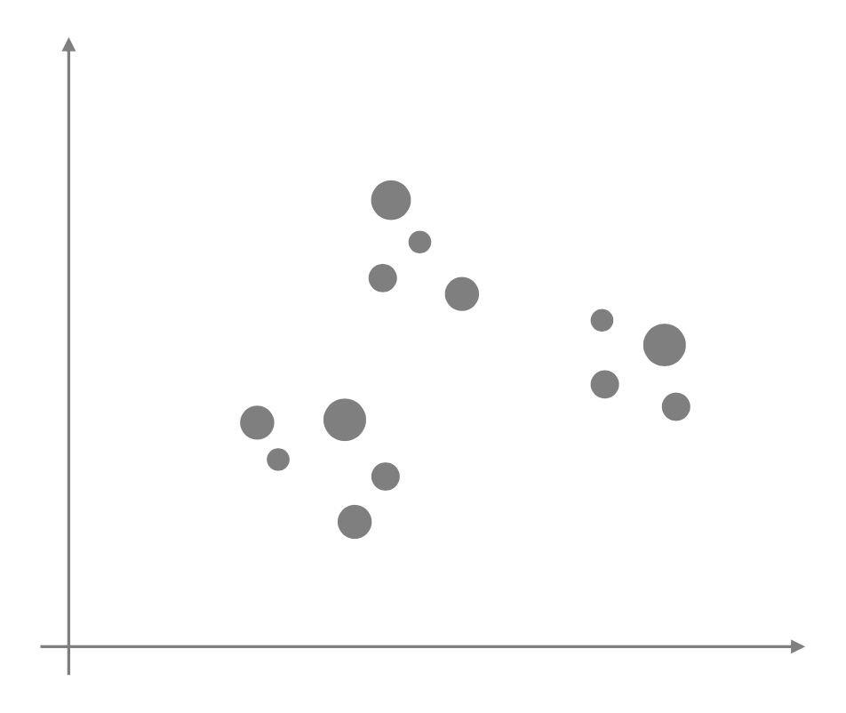
Visual Variables: Size

Slide 13
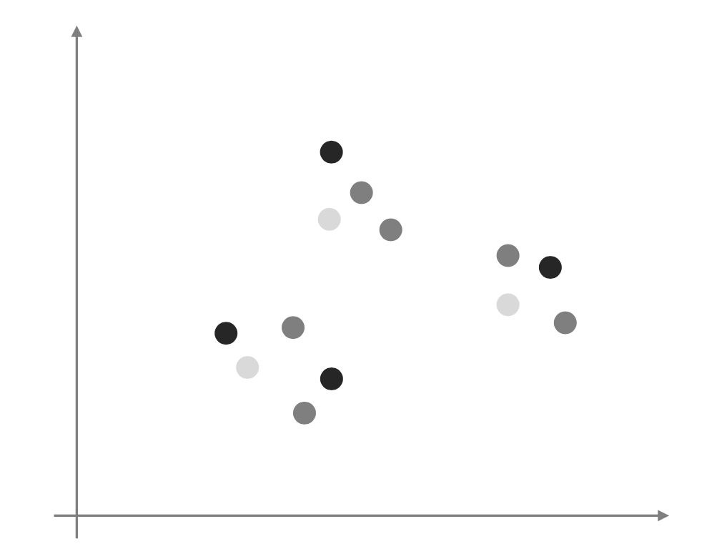
Visual Variables: Brightness

Slide 14
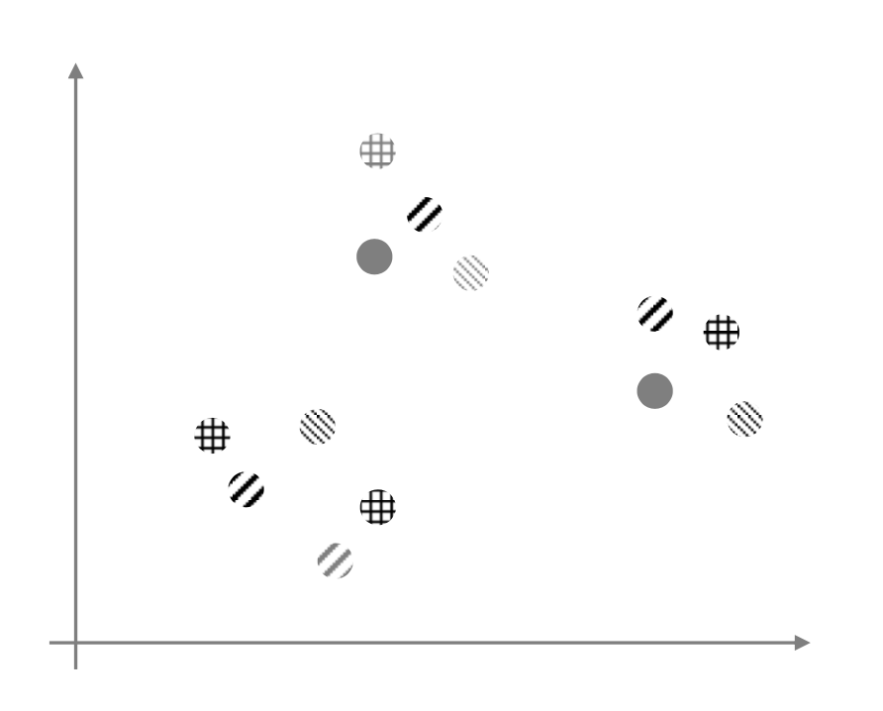
Visual Variables: Texture

Slide 15
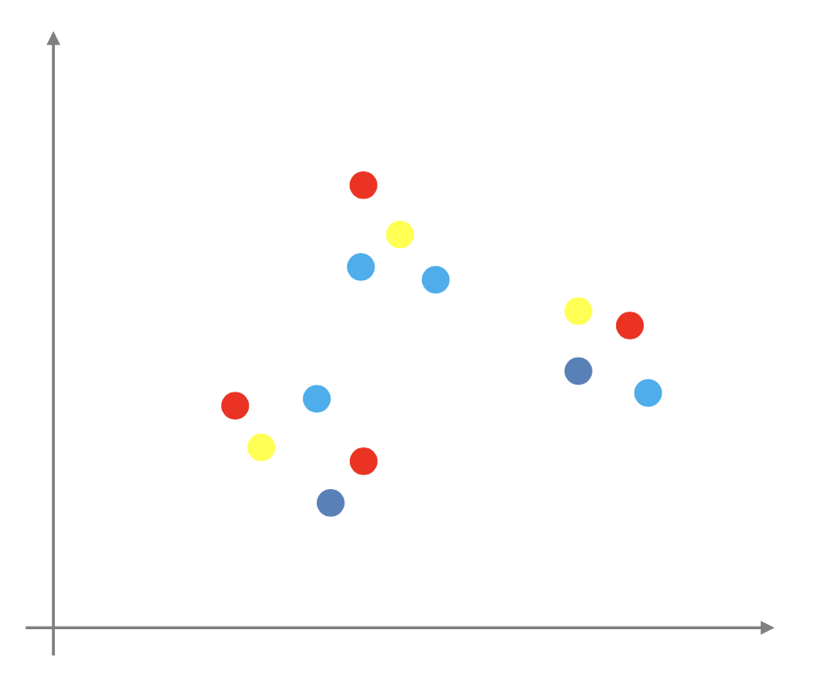
Visual Variables: Color

Slide 16
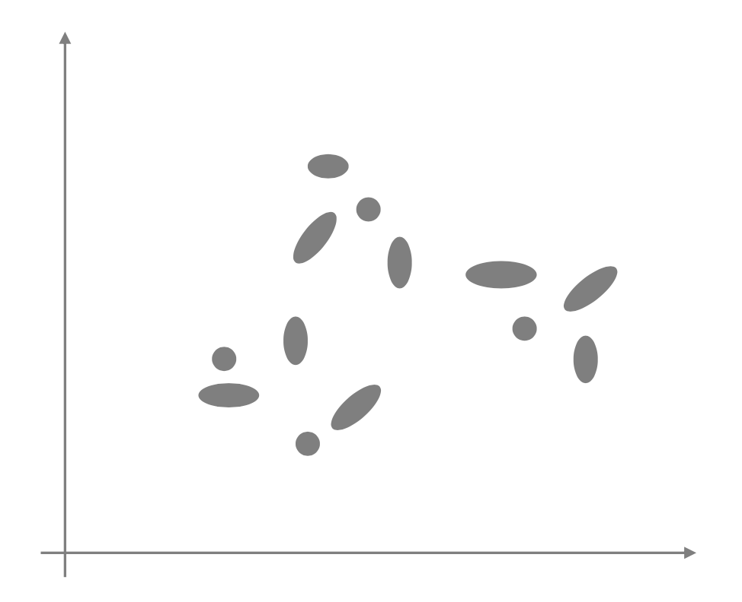
Visual Variables: Orientation

Slide 17
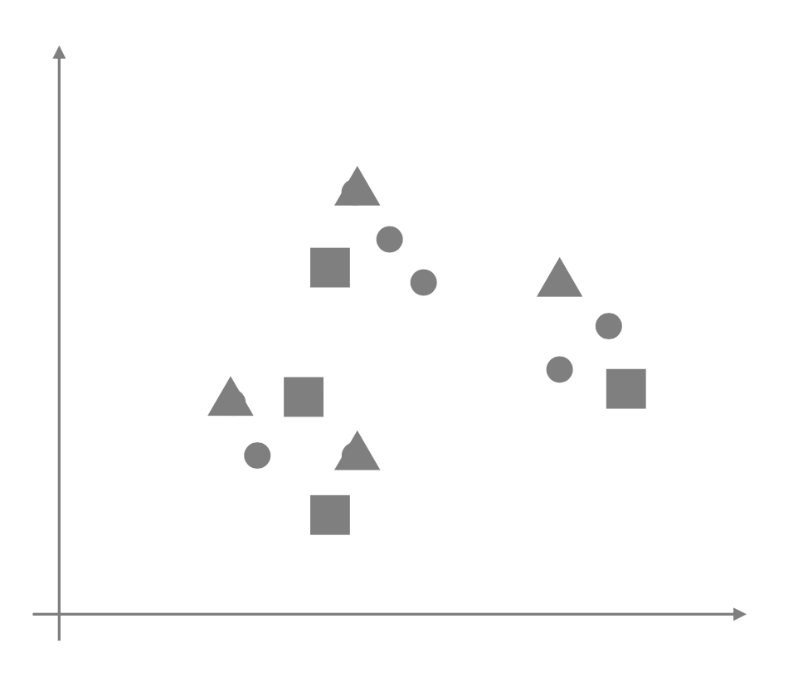
Visual Variables: Shape

Slide 18
Take Aways
Planar variable is the strongest visual variable
maps to proximity
provides an intuitive organization of information
things close together are perceptually grouped together
Size and brightness are good secondary visual variables to encode relative magnitude
Color is a good visual variable for labeling
texture can do this as well, but it does not support pop-out much
Shape provides only limited pop-out

Slide 19
Visual Analytics (VA)

Slide 20
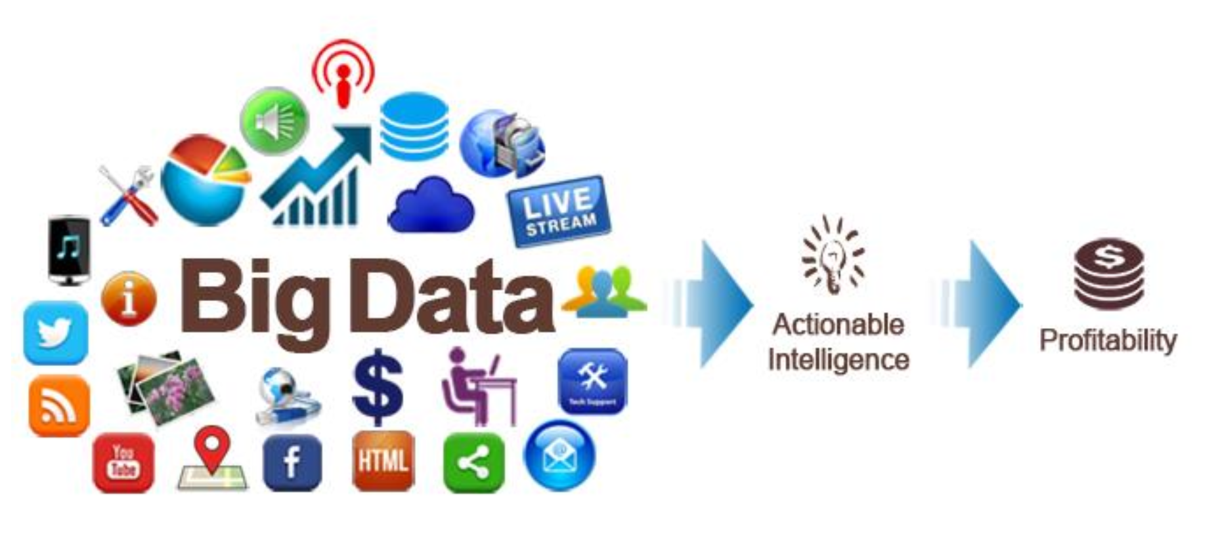
Visual Analytics

Slide 21
Challenges with Scalability for Big Data
Must be scalable to
Number of data points
Number of dimensions
Data sources
Diversity of data sources (heterogeneity)
Number of users
Quality of the data

Slide 22
Challenges with Scalability for Big Data
Must be scalable to
Number of data points
Number of dimensions
Data sources
Diversity of data sources (heterogeneity)
Number of users
Quality of the data
Visual Analytics can help!

Slide 23
What is Visual Analytics
Visualization plus...
Interaction (HCI)
Data processing (analytics)
Scientific approach
Storytelling
but also...
intelligent computing (AI, machine learning)
behavioral psychology (cognitive science, human factors)
Visual Analytics is the process of analytical reasoning supported by a highly interactive visual interface/tool

Slide 24
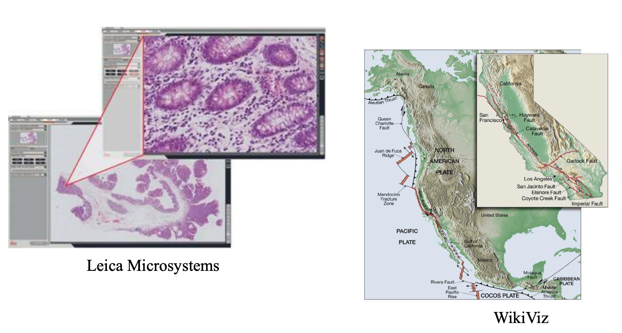
Visual Information Seeking Mantra
Ben Shneiderman’s Mantra:
Overview, zoom and filter, then details-on-demand!
Overview and detail:
disjoint views
but: they simultaneously
shows both overview and details
require the viewer to consciously shift the focus of attention

Slide 25
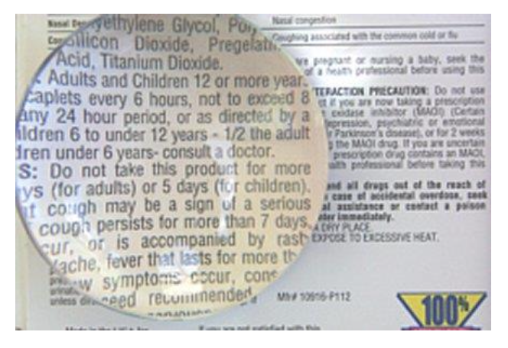
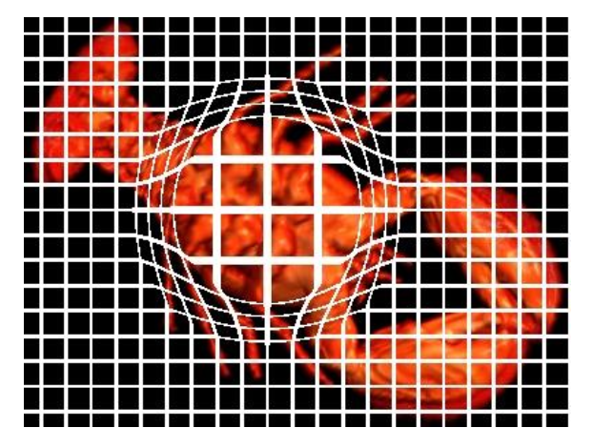
Another Paradigm: Focus + Context
Focus + Context:
one single view which shows information in direct context
maintains continuity across the display
do not require viewer to shift back and forth
a good F+C paradigm is the lens
but: there is distortion

Slide 26
Challenges in Big Data Analytics
Huge amounts of data
Intelligence analysis is challenging
Low Signal to Noise ratio (SNR)
Many data types
Text, image, video, sensor, social media, IoT data etc…
Uncertainty
Missing data
The list goes on …..

Slide 27
Use of Visualization
Visual Perception
High bandwidth of human vision
Fast screening of lot of data
Pattern recognition
High-level cognition
Interaction
Direct manipulation of data and visualization
Two-way communication
Humans are important!
But Humans are imperfect too!!

Slide 28
Humans Are Imperfect
Humans tend to overlook/ignore non-focused (and unexpected) objects even when they are very close and obvious
Humans also have limited working memory
fine details are quickly forgotten when focus changes
need to preserve temporal context

Slide 29
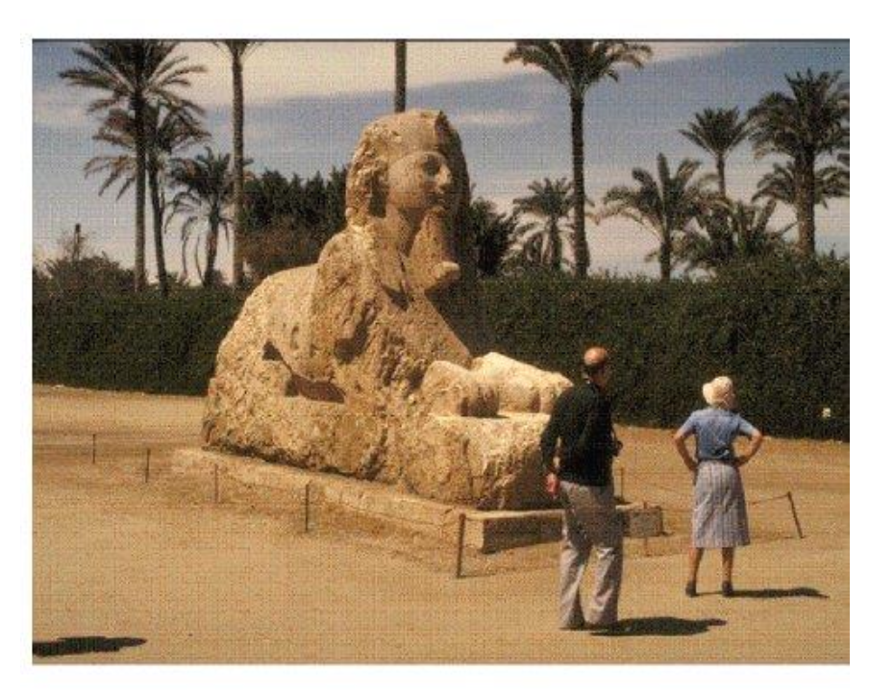
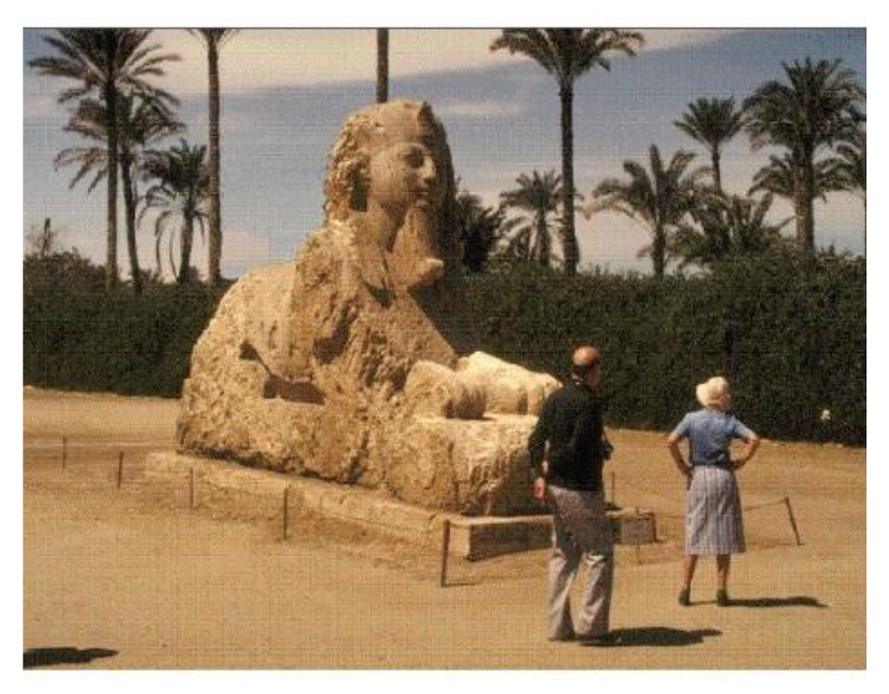
Humans Are Imperfect
Spot the difference: Change blindness

Slide 30
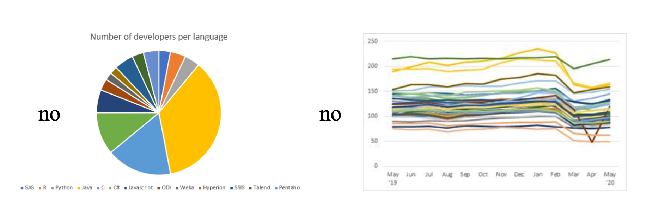
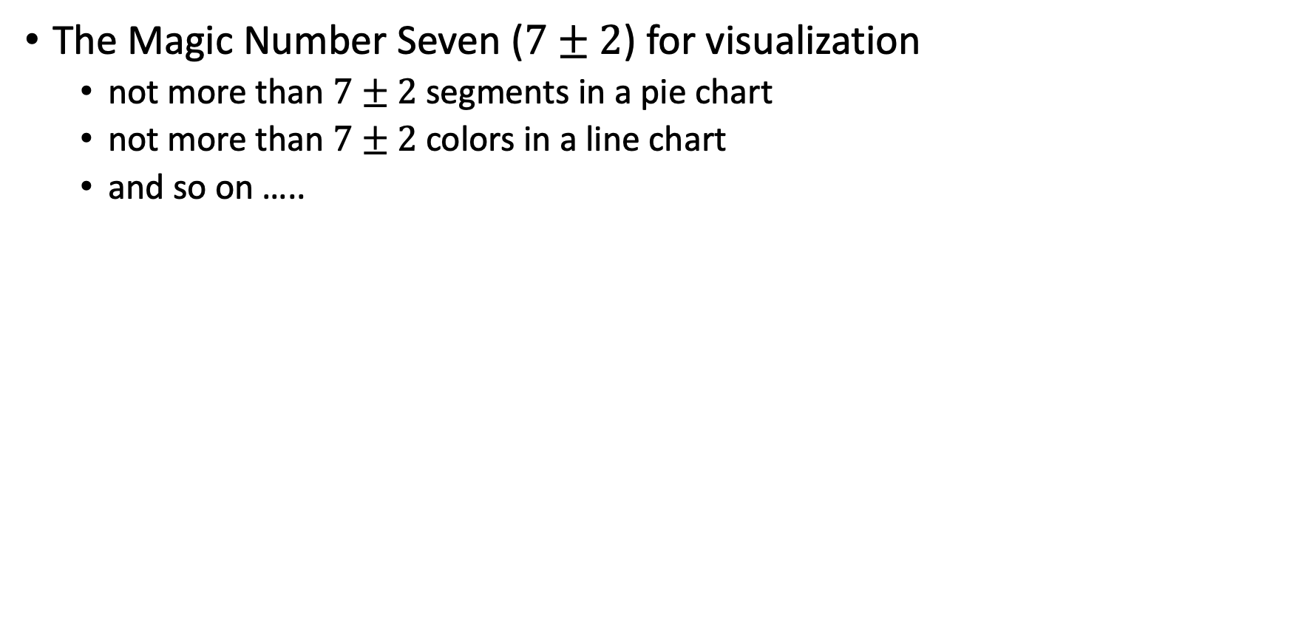
Human Limitations for Visualization
The Magic Number Seven ($7±2$) for visualization
not more than $7±2$ segments in a pie chart
not more than $7±2$ colors in a line chart
and so on …..
Miller, G.. (1956). "The magical number seven, plus or minus two: Some limits on our capacity for processing information".

Slide 31
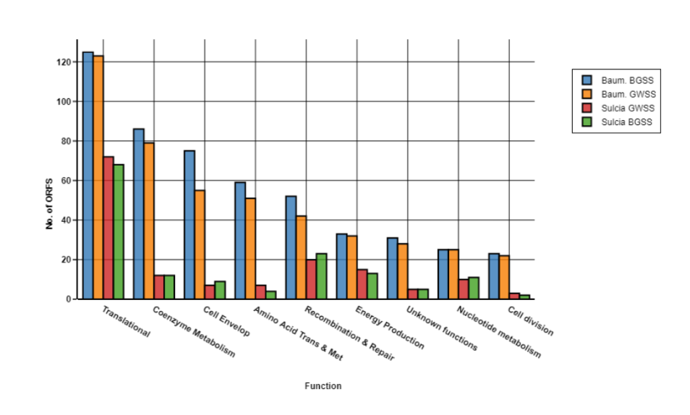
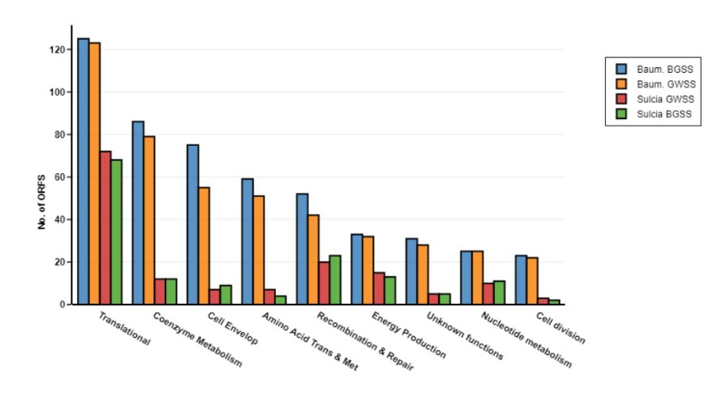
Visual Complexity
Do we need the background grid?
Maybe not!

Slide 32
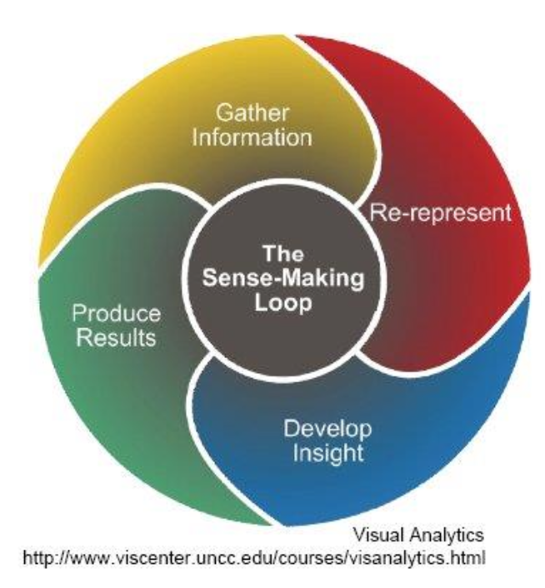
Strategies for Dealing with Complexity
Decomposition
decompose a complex problem into simpler problems
Externalization
get the decomposed problem out of your head and down on paper or on a computer screen in some simplified form
show the main variables, parameters, or elements of the problem and how they relate to each other
Recall Visualization Mantra:
overview and detail
focus and context
analyze, filter, zoom,...

Slide 33
Handling Data

Slide 34
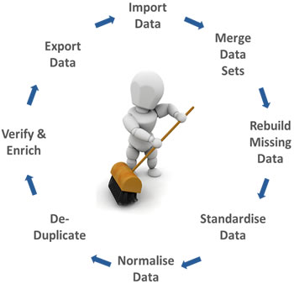
What Do We Do After Getting the Raw Data?
Real world data can be dirty!
Data cleaning (Wrangling)
Missing values
Noisy data
Deal with outliers
Standardize/normalize
Resolve inconsistency
Fuse/merge
Data Cleaning Cycle
https://blog.insycle.com/data-cleaning-hubspot

Slide 35
Missing Data: Why?
Data may not be always available/complete!
Missing data may be due to
equipment malfunction
inconsistent with other recorded data and thus deleted
data not entered due to misunderstanding
certain data may not be considered important at the time of entry
many more other reasons

Slide 36
Missing Data: How to Handle?
How would you estimate the missing value for a dataset?
Ignore or put in a default value
Manually fill in (can be tedious or infeasible for large data)
Use the available value of the nearest neighbor
Average over all the values
Use a probabilistic methods (regression, Bayesian, decision tree)
Use AI/ML models to predict missing data

Slide 37
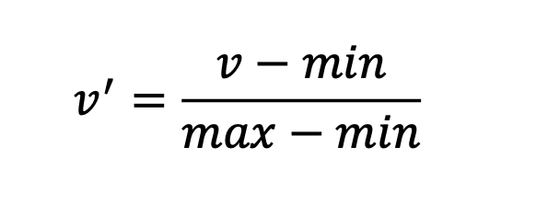
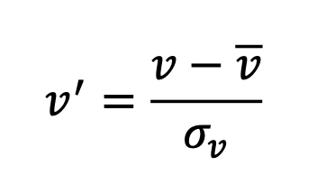
Data Normalization and Standardization
Sometimes we like to have all variables on the same scale
Min-max normalization
Standardization

Slide 38
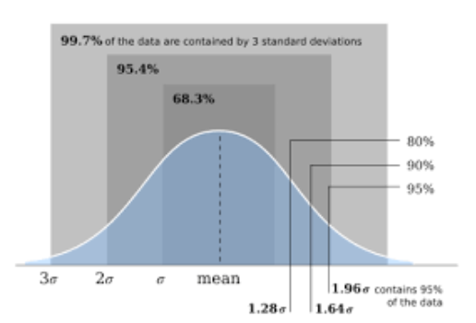
Data Normalization and Standardization
Sometimes we like to have all variables on the same scale
Min-max normalization
Standardization
Clipping tails and outliers
set all values beyond ± 3s to value at 3s

Slide 39
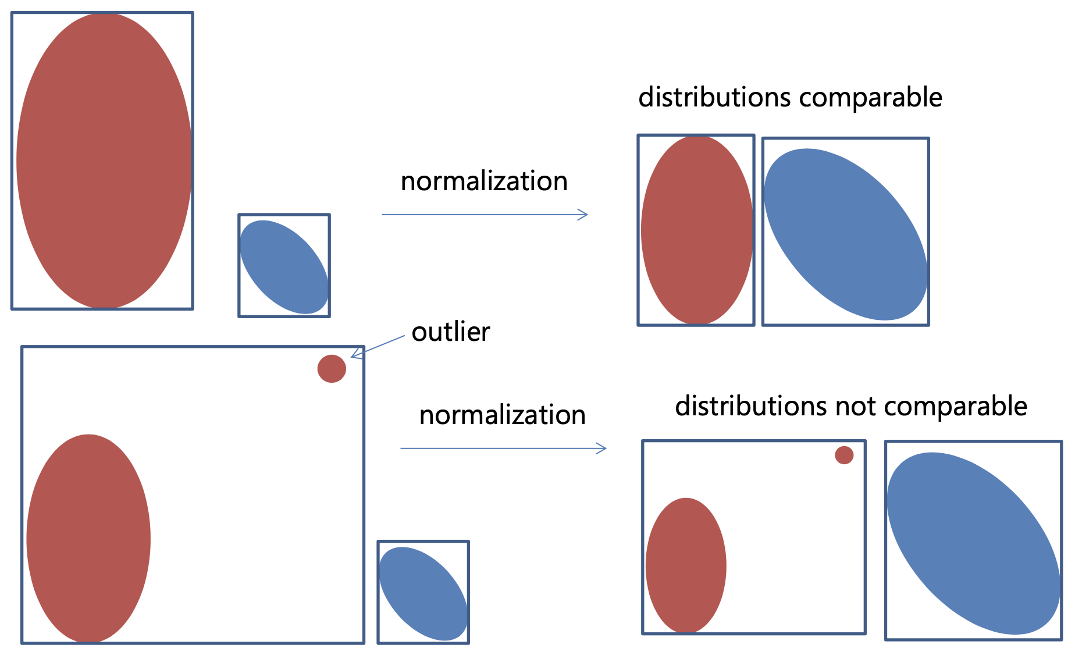
Normalization

Slide 40
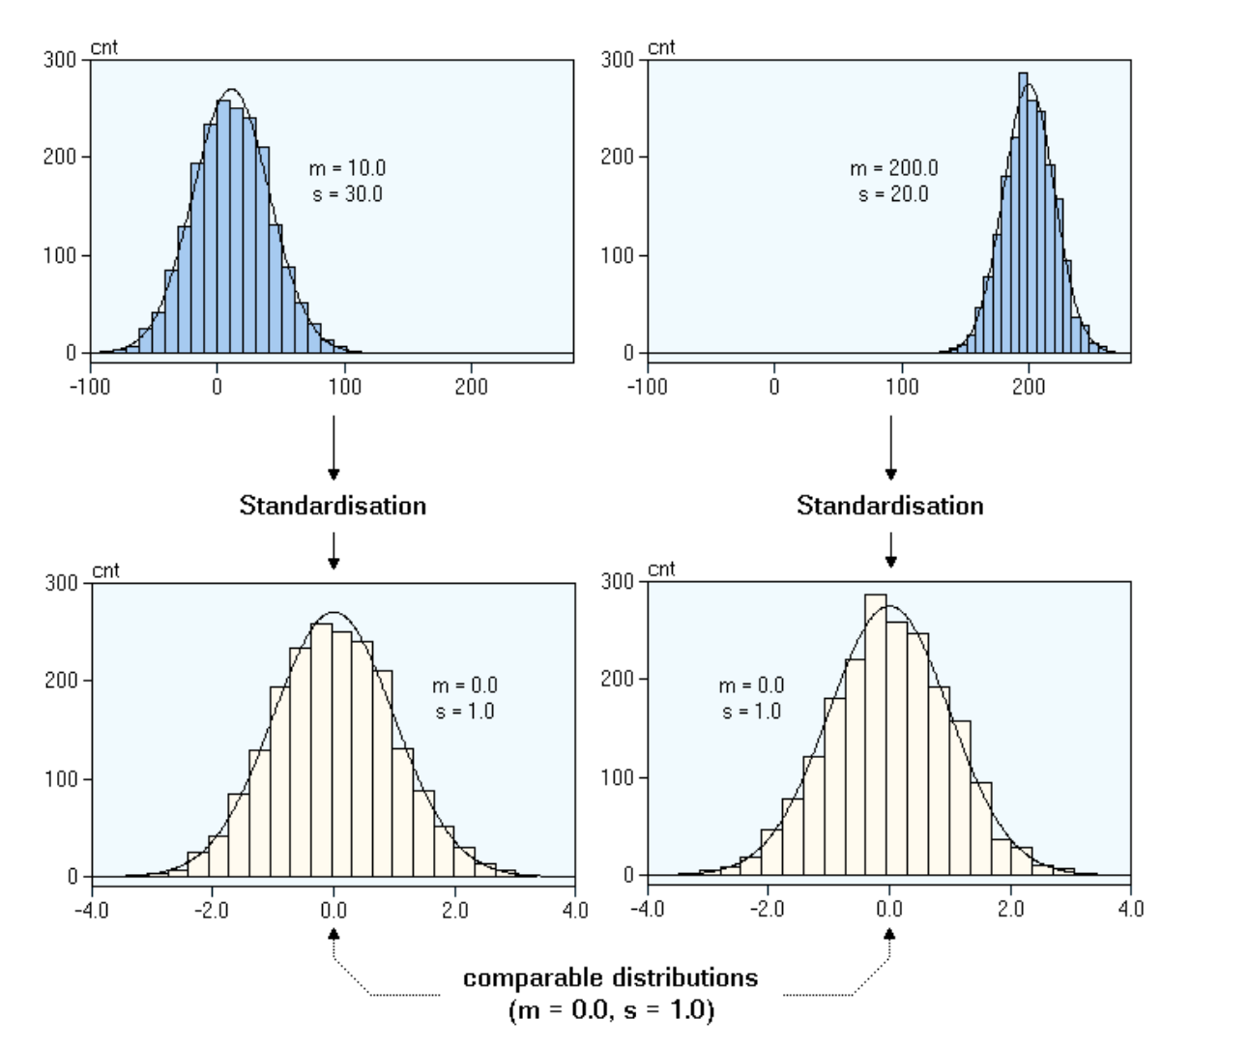
Standardization

Slide 41
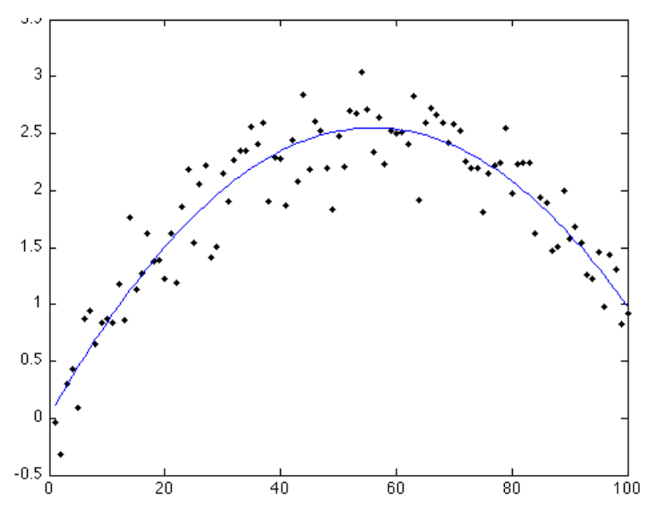
Noisy Data
Noise = Random error in a measured variable
faulty data collection instruments
Data entry problems
data transmission problems
technology limitation
inconsistency in naming convention

Slide 42
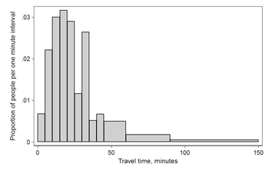
Noisy Data: What to Do?
Binning
Replace data with bin centers

Slide 43
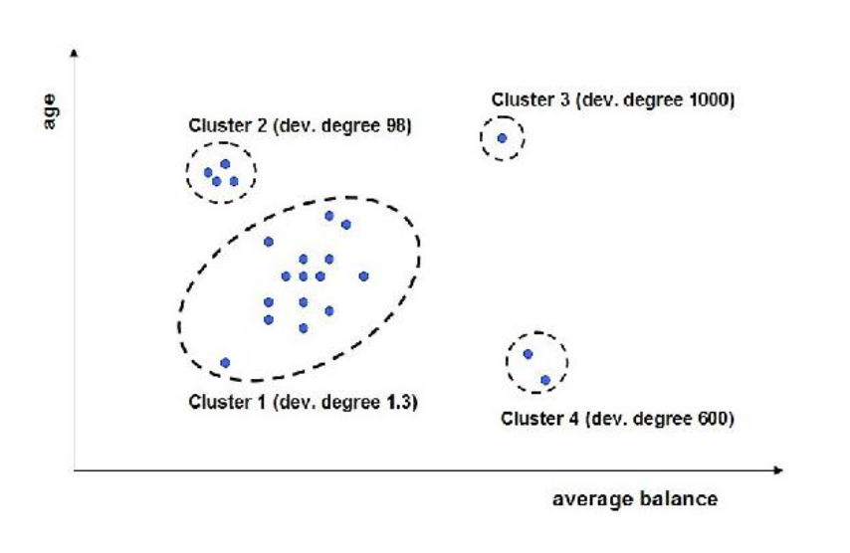
Noisy Data: What to Do?
Binning
Replace data with bin centers
Clustering
Detect and remove outliers

Slide 44
Noisy Data: What to Do?
Binning
Replace data with bin centers
Clustering
Detect and remove outliers
Semi-automated method
Combined human and computer inspection
Detect suspicious value and check manually

Slide 45
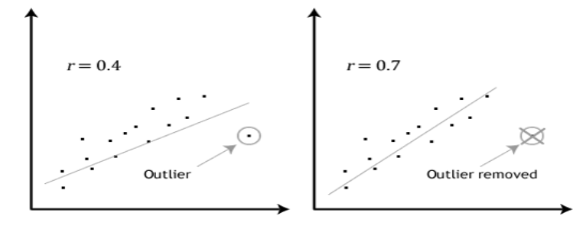
Noisy Data: What to Do?
Binning
Replace data with bin centers
Clustering
Detect and remove outliers
Semi-automated method
Combined human and computer inspection
Detect suspicious value and check manually
Regression
Smooth data by fitting to a regression function

Slide 46
Noisy Data: What to Do?
Binning
Replace data with bin centers
Clustering
Detect and remove outliers
Semi-automated method
Combined human and computer inspection
Detect suspicious value and check manually
Regression
Smooth data by fitting to a regression function
Outliers are not always noise! Be careful!

Slide 47
Deal with Small Data
Can you invent new data?

Slide 48
Deal with Small Data → Data Augmentation
Can you invent new data?
Data Augmentation
Strategy to artificially synthesize new data from existing data

Slide 49


Deal with Small Data → Data Augmentation
Can you invent new data?
Data Augmentation
Strategy to artificially synthesize new data from existing data
Common techniques are (for images)
rotations
Translations
Zooms
Flips
color perturbations
crops
add noise by jittering

Slide 50
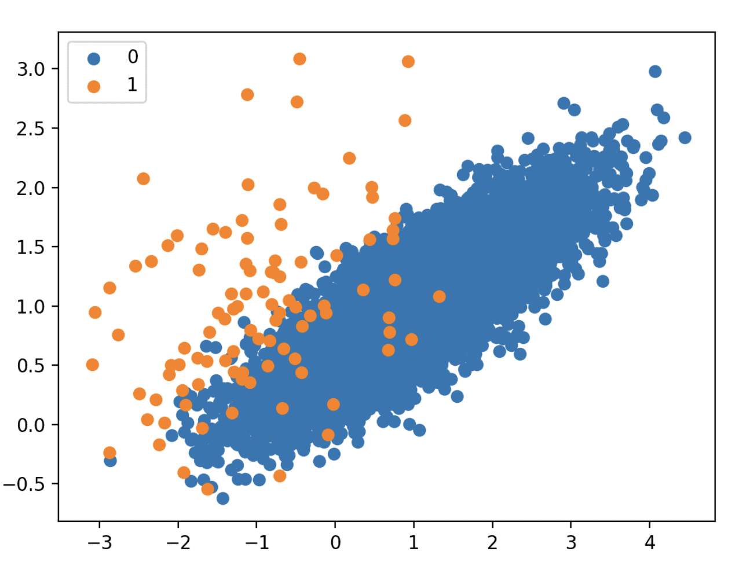
Synthetic Data Generation for Imbalanced Classification
When data has severe imbalance in the class representation
If you use such data for ML model training, it will perform poorly for the minority class
SMOTE (Synthetic Minority Oversampling Technique) can help
A data augmentation method
Imbalanced Data

Slide 51
SMOTE: Synthetic Data Generation for Imbalanced Classification
How do we generate samples for minority class?
Randomly under-sample the majority class
Select a minority class instance (x) at random and find its k-nearest minority class neighbors
Select one of the k neighbors at random, say (y)
The synthetic instances are generated as a convex combination of the two chosen instances x and y

Slide 52
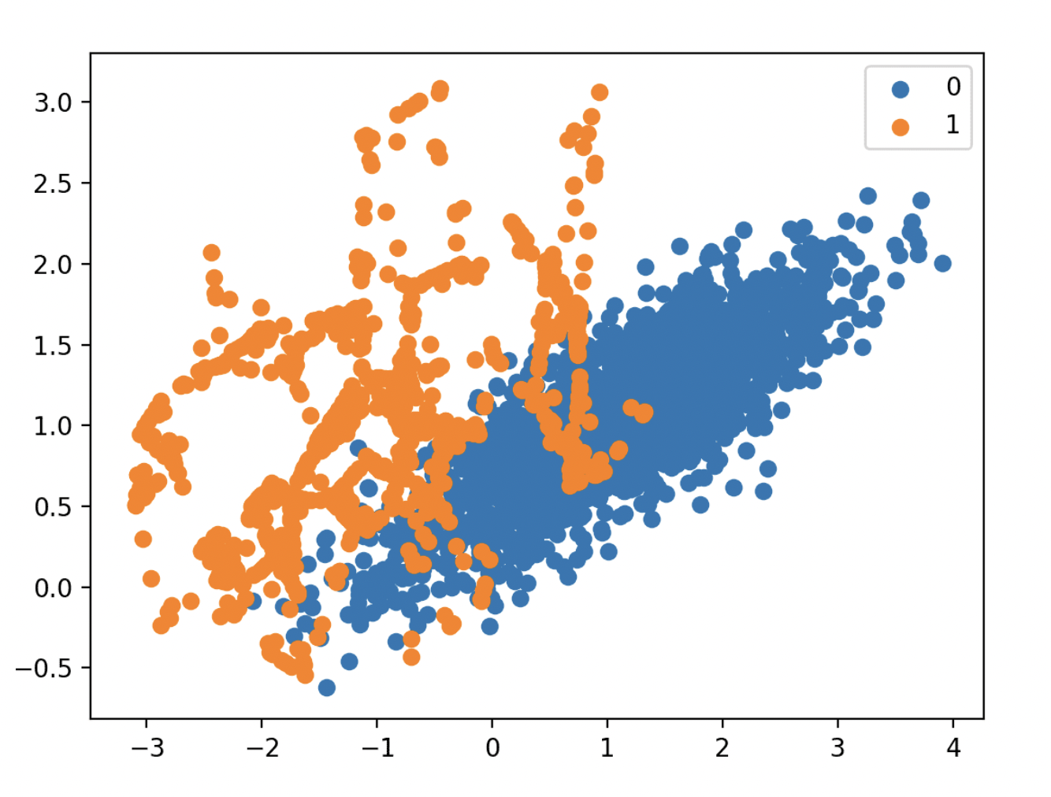
SMOTE: Synthetic Data Generation for Imbalanced Classification
Example:
Imbalanced Data
SMOTE + random under-sampling
https://machinelearningmastery.com/smote-oversampling-for-imbalanced-classification/

Slide 53
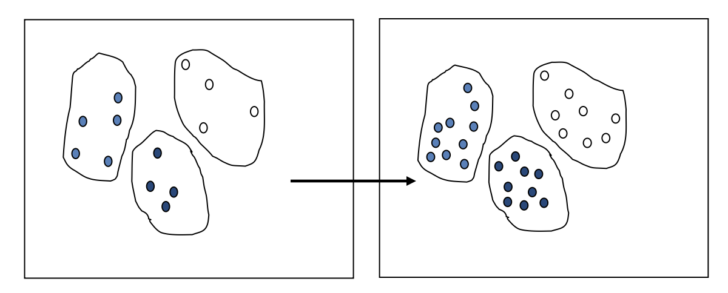
Data Augmentation for Visualization and VA
Generate new samples according to the data distributions
Cluster the data (outliers may form clusters!)
The size of each cluster represents its percentage in the population
Randomize new samples – bigger clusters get more samples
Augmentation rate ~ Cluster size

Slide 54
Deal with Big Data → Data Reduction!
Purpose
reduce the data to a size that can be feasibly stored
reduce the data so a mining algorithm can be feasibly run
Alternatives
buy more storage
buy more computers or faster ones
develop more efficient algorithms
In practice, all of this is happening at the same time
but the growth of data and complexities is faster
and so, data reduction is important !

Slide 55

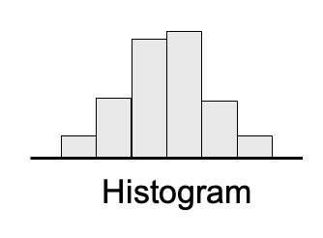
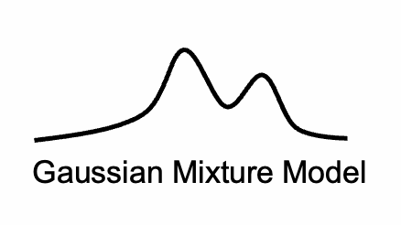
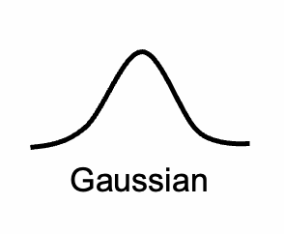
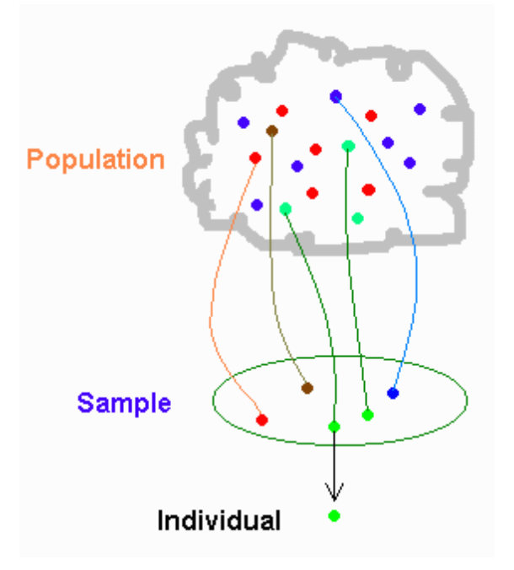
Data Reduction: How?
Summarization (Later in the course)
Binning
Distribution-based
Clustering
Machine Learning
Sampling (Later in the course)
Systematic/Regular
Random
Stratified
Adaptive/Data-driven
Importance-driven
Cluster-based
Dimension Reduction (Later in the course)
Other ways possible..
Summary Data
Big Data
Sampling

